Slide 1
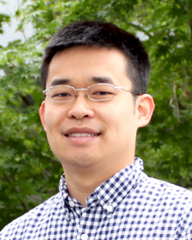
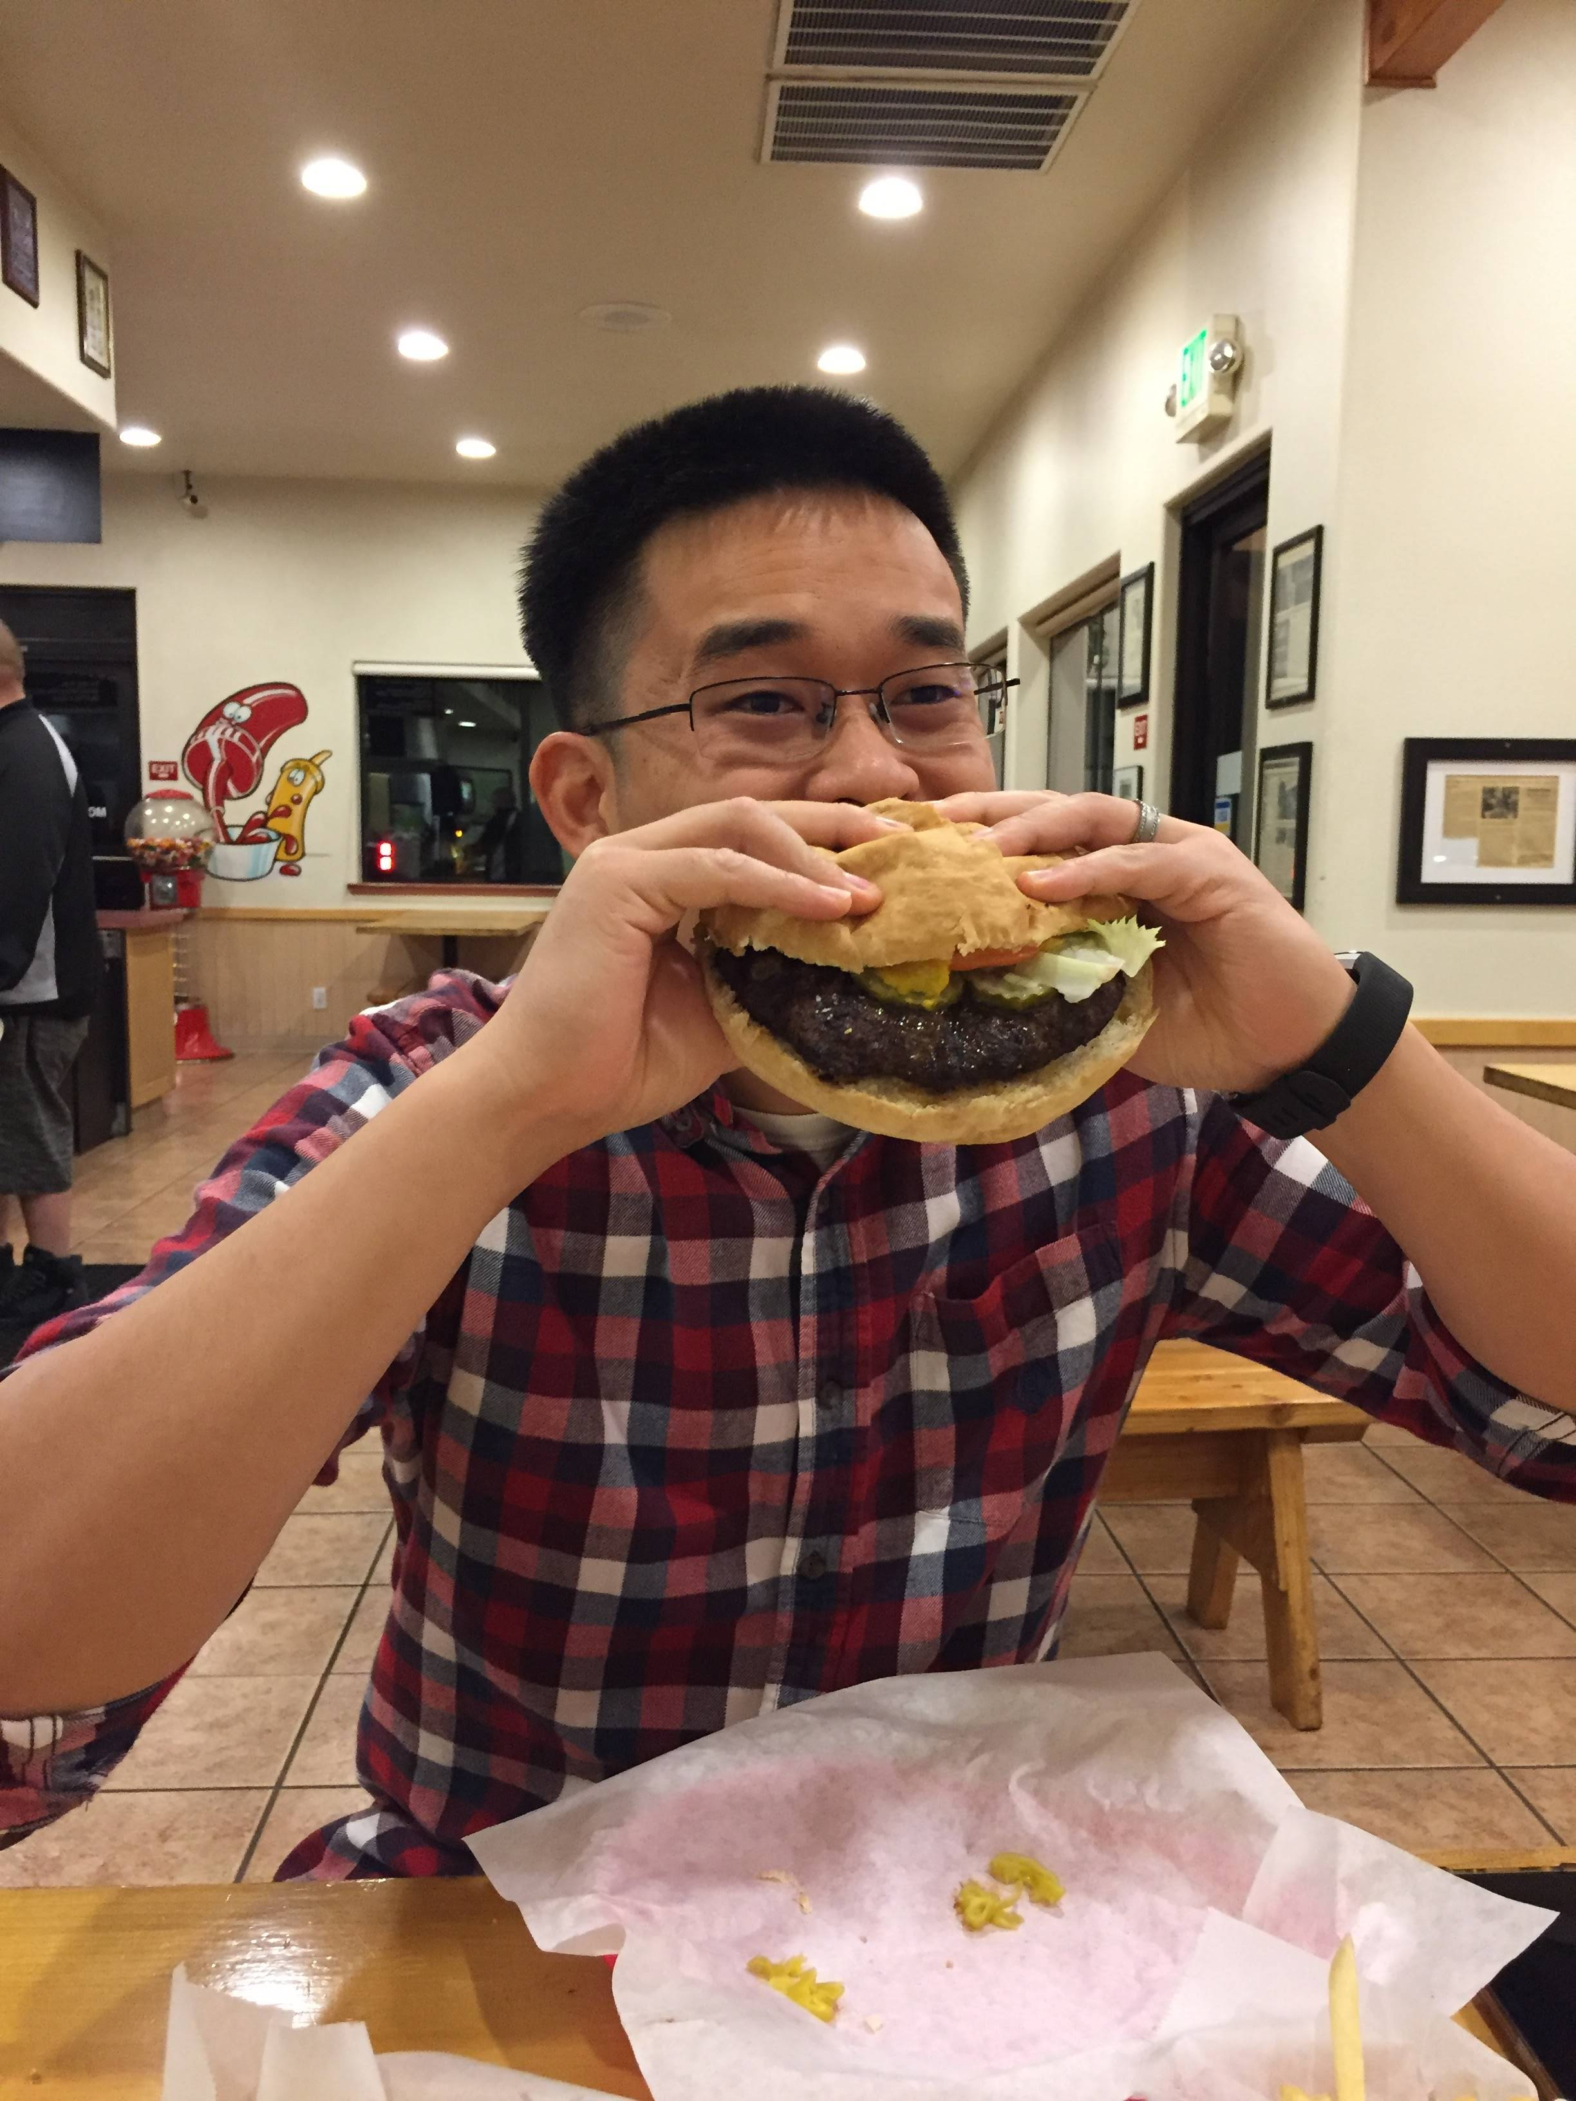
Stewart He
Science & Engineering: member of technical staff at LLNL
Joined LLNL in 2017 and worked on:
Pilot 1 – modeling drug tumor response
GA-drugs LDRD – predicting free energies from MD simulations
AHA – running safety and pharmacokinetic predictions on 1.6 billion drugs for Covid-19.
ATOM – Applying PQSAR to public datasets.
Education:
BS from UC Berkeley in EECS
PhD from UC Davis in Computer Science
Keywords:
Machine learning, drug development, hamburgers, Dungeons and Dragons, video games.
he6@llnl.gov
1lb burger from Big Chico Burger

